Slide 1
Introduction to Zero Trust & Threat Landscape
Indranil Dutta
Principal Clous Solution Architect
Global Partner Solutions – Microsoft
Email:Indranil.Dutta@microsoft.com

Slide 2


Digital transformation roadmap
We just completed more than 2 years of digital transformation in 2 weeks.
Secure Budget for V1 Pilots
Evaluate learnings and scope V2 Pilots
120 day pilots with select teams
Begin team-by-team rollouts
Scope requirements for Work-from-Anywhere transformation initiative
90 day pilots: BYOD, 1-day-WFH, remote meetings
Secure Budget for V2 Pilots
Develop training and internal PR
Complete Work-from-Anywhere rollout
Jan 1, 2020
Jun 1, 2022

Slide 3

Digital transformation roadmap
We just completed more than 2 years of digital transformation in 2 weeks.
“We have seen two years’ worth of digital transformation in two months.“
Satya Nadella Microsoft CEO
Complete Work-from-Anywhere rollout
Begin team-by-team rollouts
Develop training and internal PR
120 day pilots with select teams
Secure Budget for V2 Pilots
Evaluate learnings and scope V2 Pilots
Scope requirements for Work-from-Anywhere transformation initiative
90 day pilots: BYOD, 1-day-WFH, remote meetings
Secure Budget for V1 Pilots
Jan 1, 2020
Apr 1, 2020
Jun 1, 2022
Notes:
Customers had long roadmaps previously for digital transformation - roadmaps would be 2 years, with COVID it was reduced to 2 months
With COVID we've seen things speed up, with customers deploying Conditional Access very quickly
"We have seen two years' worth of digital transformation in two months" Satya Nadella

Slide 4


Old World vs. Current World
Users are employees
Employees, partners, customers, bots
Corporate managed devices
Bring your own devices and IoT
On-premises apps
Explosion of cloud apps
Monolithic apps
Composite apps & public restful APIs
Corp network and firewall
Expanding Perimeters
Local packet tracking and logs
Explosion of signal

Slide 5

Zero Trust
ALT: A modern approach to security that uses adaptive controls and continuous verification to secure access across your entire digital estate.
Never Trust, Always Verify
A modern approach to security which treats every access attempt as if it’s originating from an untrusted network
Notes:
This is where Zero Trust comes in play! Zero Trust is a modern security approach with treats every access attempt like it’s coming from an untrusted network. This approach no longer relies on trusting the corporate network and is very relevant to our current world where several of us are working from home.

Slide 6


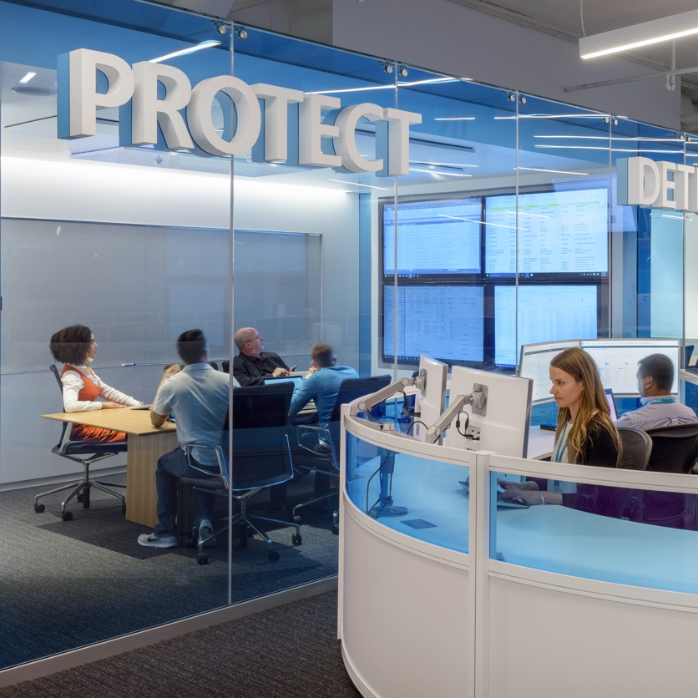
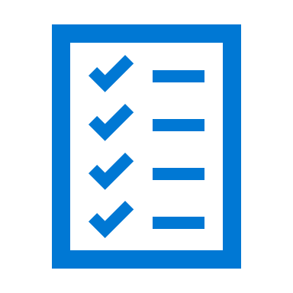


Zero Trust principles and holistic security strategy
Verify explicitly
Use least privilege access
Assume breach
Notes:
We are living in a new reality where the old security paradigms no longer apply.
Even before these unprecedented times, we knew that we could no longer trust that everything behind the corporate firewall was safe.
Now more than ever, customers need your help to move to a Zero Trust posture to safeguard company resources.
Zero Trust is a simple concept that follows 3 core principles: ​
Verify explicitly. Always authenticate and authorize based on who the user is, where they are coming from, device they are on, and what data and application they are trying to access. ​
Use least privileged access. Limit user access with Just In Time and Just Enough Access (JIT/JEA), risk based adaptive polices, and data protection. ​
Always Assume breach. Leverage analytics which will minimize blast radius and prevent lateral movement, and ensure sessions are encrypted end –to-end

Slide 7

Zero Trust architecture
Zero Trust across the esate
Identities
Data
Organization policies
Identities
Infrastructure
Real-time policy evaluation
Apps
Devices
Network
Visibility, Analytics, Automation
Notes:
The Zero Trust approach should extend throughout the entire digital estate—it serves as an integrated security philosophy and an end-to-end strategy. ​
Organizations do this by implementing Zero Trust controls and technologies across the six foundational elements that you see on the slide.
Each organization’s Zero Trust journey is unique. White it can start with any pillar, the most logical path for most customers is starting with a cloud identity.

Slide 8
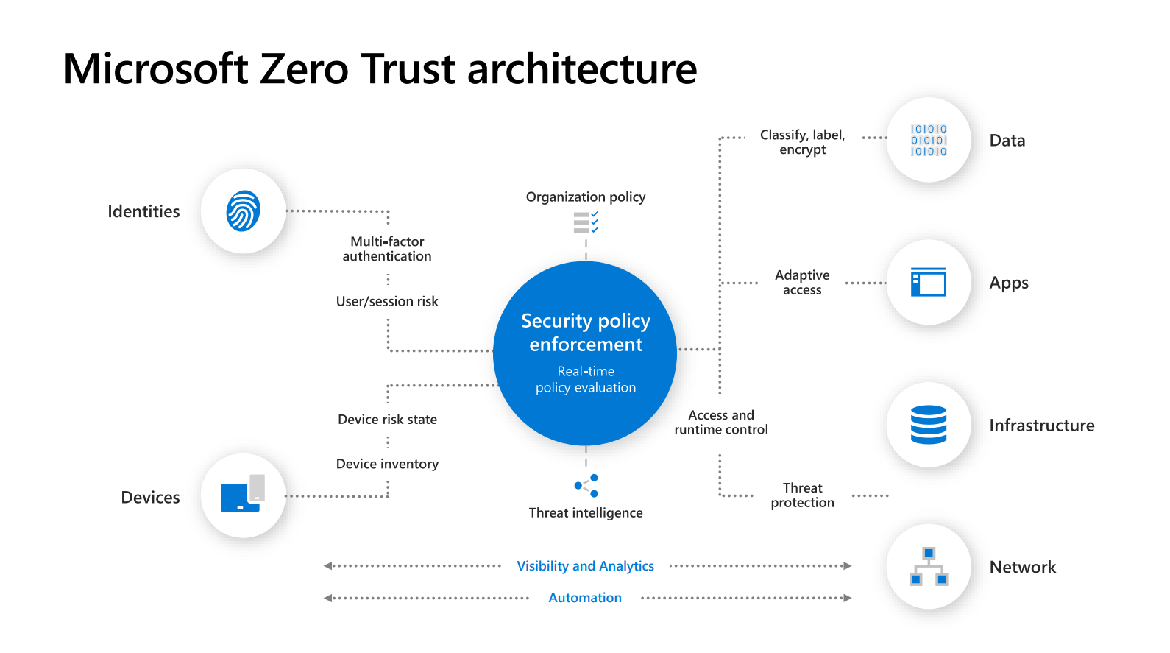

Slide 9
Helping you build a strong identity foundation
Strengthen your credentials
Reduce your attack surface area
Automate threat response
Utilize cloud intelligence
Empower end users with self-service
AKA.MS/SECURITYSTEPS

Slide 10
Start with a strong identity foundation in the cloud

Slide 11

Azure Active Directory – the world’s largest cloud identity service
200K +
Azure AD
Premium organizations
345M +
Azure AD
Monthly active users
30B +
Azure AD
Daily authentication requests

Slide 12











Secure access to all applications with single sign on
Cloud apps
single sign-on
Apps and data
HR systems
Azure AD
App delivery controllers & networks
Azure AD App Proxy
External users
Active Directory
On-premises perimeter-based networks
Notes:
A critical step towards starting a Zero Trust journey is consolidating secure access to all applications whether they are on-prem or in the cloud​
To get started, Azure AD can be easily synchronized with on-premises Active Directory, connected to cloud HR systems, and enabled for external users.​
With that you can enable Single Sign On to all apps including SaaS apps, custom built cloud apps, and on-prem apps. ​
For on-premises apps you can choose between Azure AD Application Proxy or one of the Secure Hybrid Access integrations from Akamai, Citrix, F5 or Zscaler. These solutions help customers access legacy auth based applications that use protocols like Header-based and Kerberos authentication. We continue to make the roll-out for integrated solutions easier – a great example is F5 “Easy” button in the Azure portal to simplify app configuration.

Slide 13
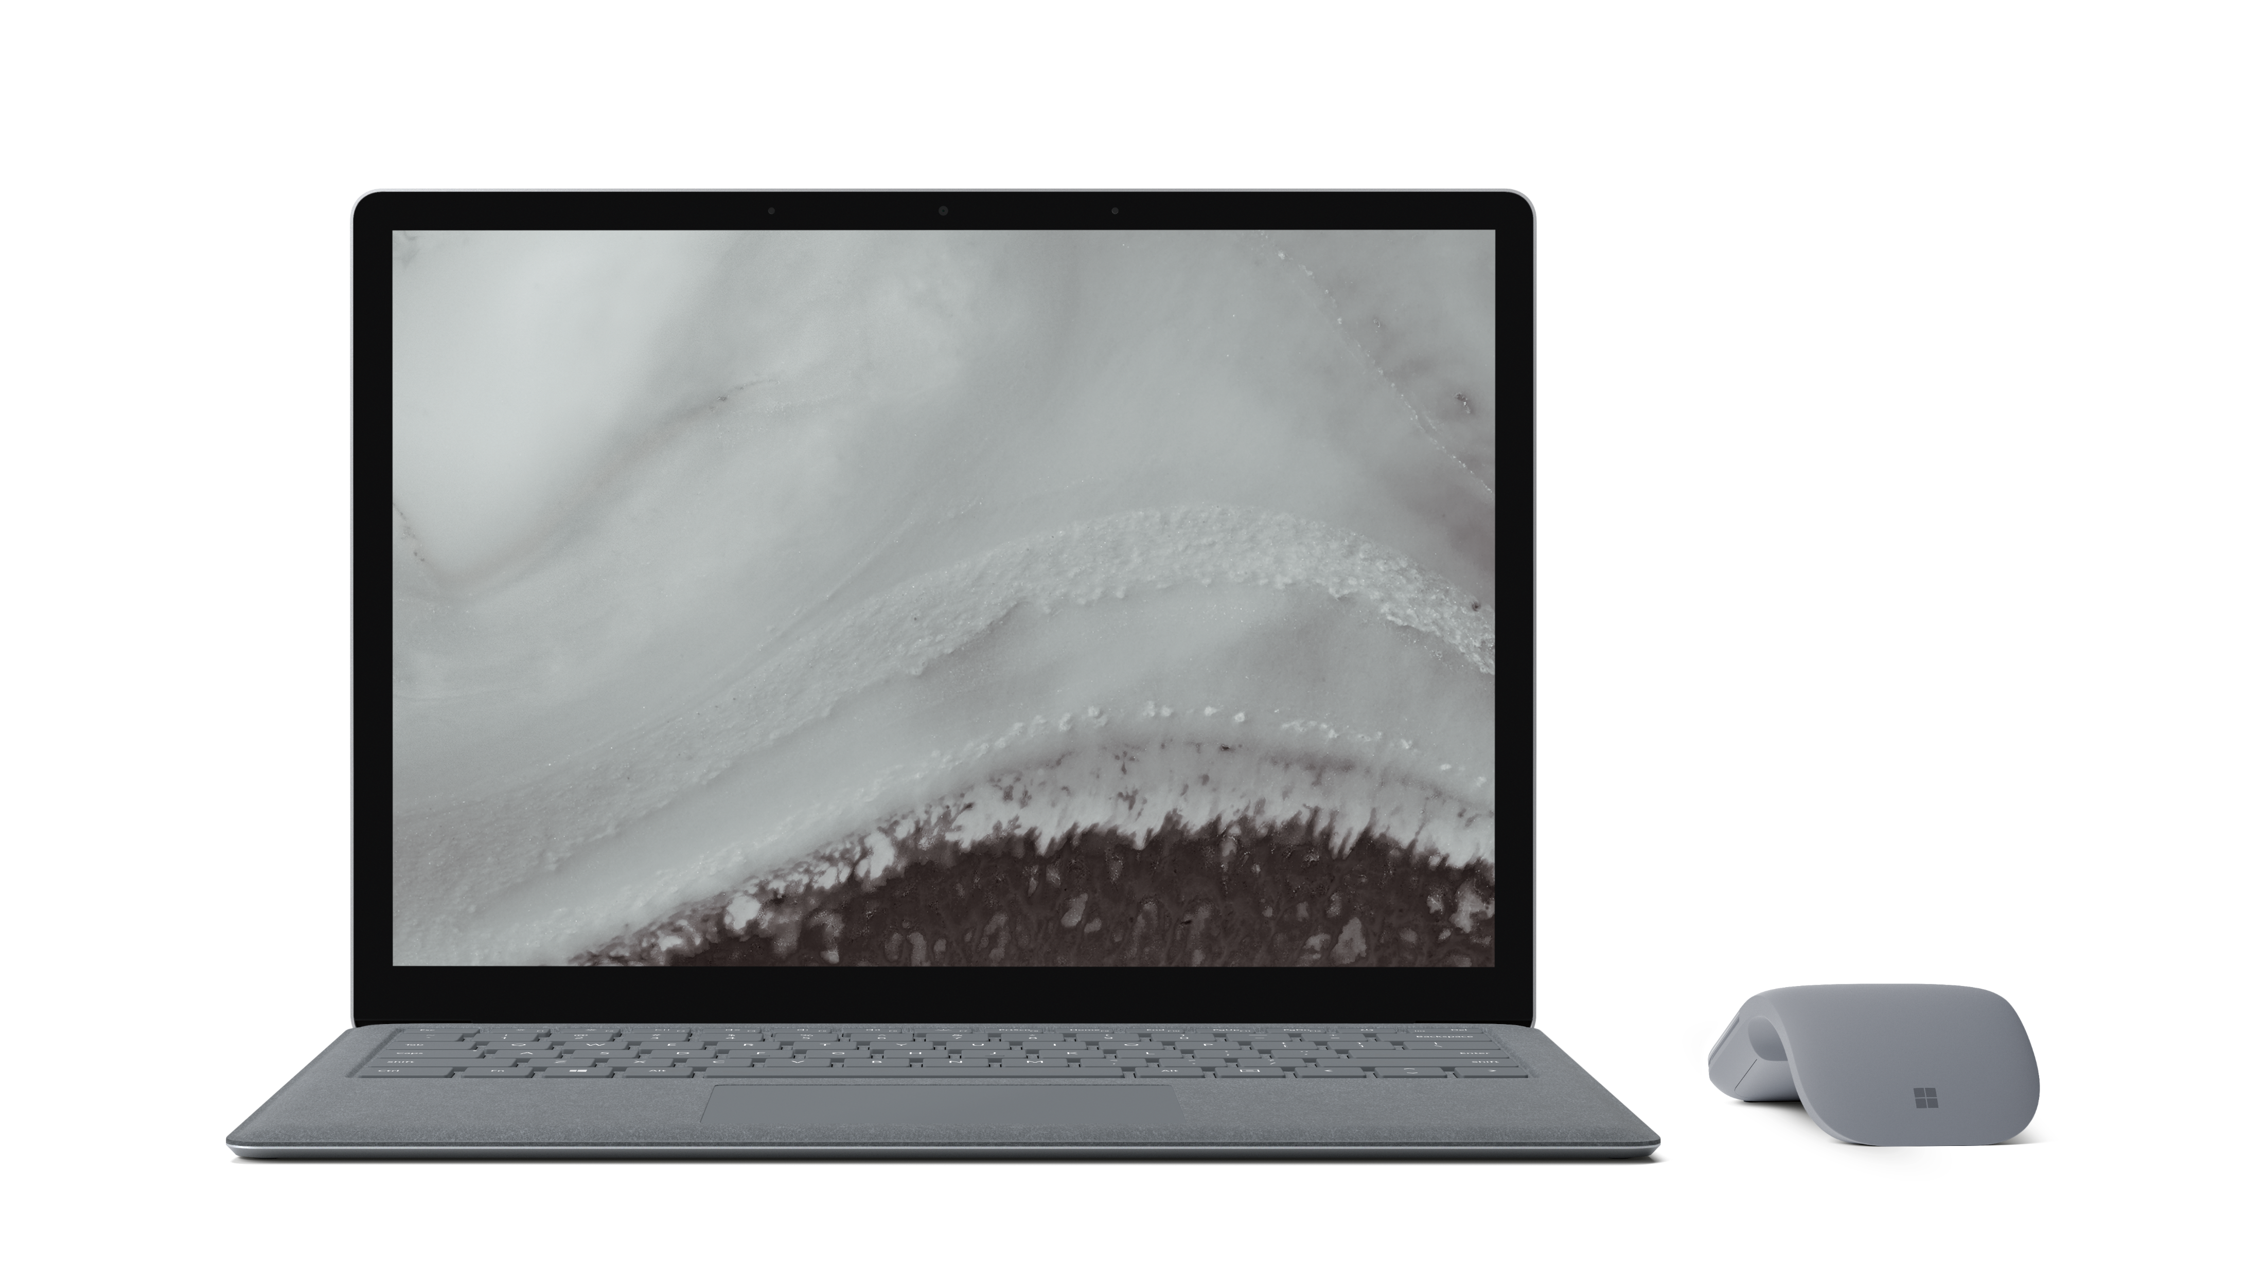
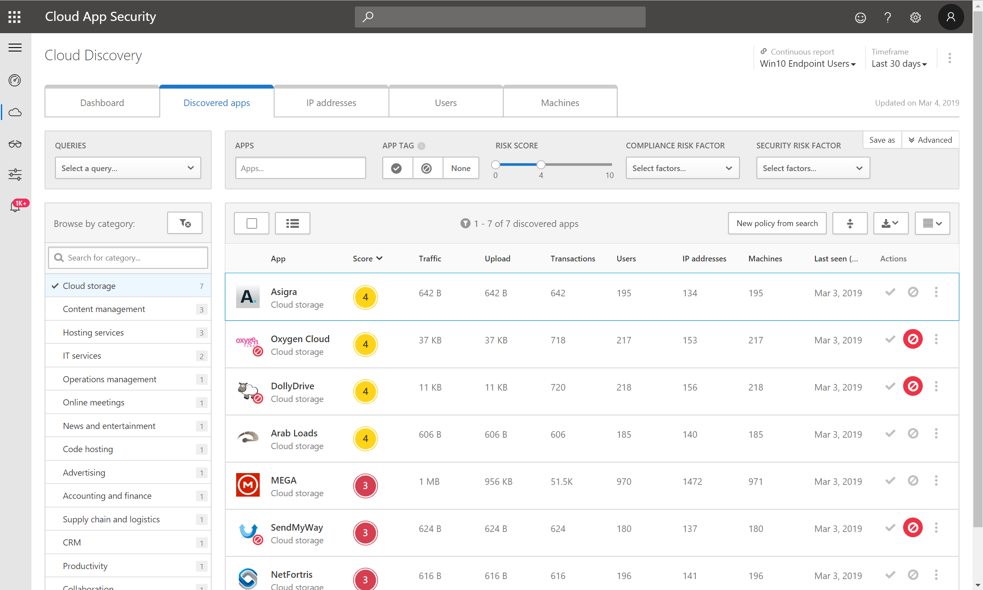
Discover cloud applications
Discover all cloud apps and services used in your organization.
Assess the risk and compliance of all cloud apps.
Govern discovered cloud apps and explore enterprise-ready alternatives.
Notes:
Key slide takeaway: Discover cloud apps being used in your organization.
Main points to cover:
We know most organizations are using cloud apps to get work done. Up until this point, we may have had a handle on the apps our organization uses.
Now, with the crisis we’re facing, and the quick shift to remote work – people in your organization may be looking for new tools and apps to fill in the gaps they face in getting their work done.
We also know there are a lot of bad actors out there trying to take advantage of the situation – we need to ensure that our people and our assets are protected when using web apps.
This means that we need to have the tools to discover usage of cloud apps and have the proper control over the usage of those apps.
Our first step is discovery: When you discover all of your cloud applications and resources, you have the opportunity to see your environment's "footprint" in the cloud.
Here we are looking at Microsoft Cloud App Security (or MCAS for short) – the central tool in Microsoft 365 that provides the cloud app discovery resources.

Slide 14
Winning strategy 1 Strengthen your credentials

Slide 15

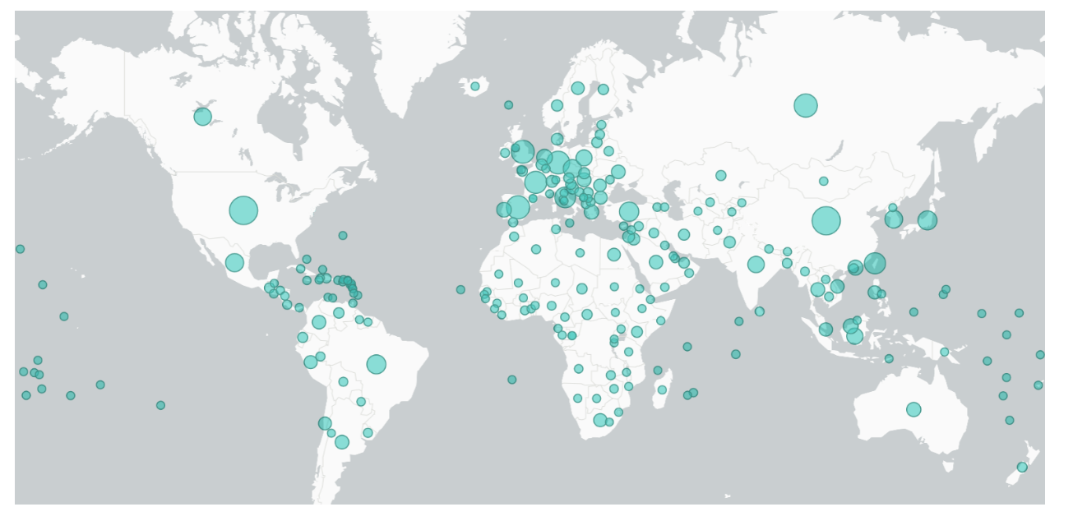
230% Increase in password spray attacks this year
Nearly 1 in 3 of all attacks on enterprises involve phishing
9M
high-risk enterprise sign-in attempts flagged in August 2020
2M
compromised accounts detected in August 2020
5.8B
attacker-driven sign-ins detected in August 2020
* Chart shows impact of COVID-19 themed attacks across the world by file count (as of April 7, 2020) / Source Microsoft Threat Intelligence
Notes:
Microsoft Citation on “Nearly 1 in 3 attacks involve phishing” https://www.microsoft.com/security/blog/2020/08/26/how-microsoft-threat-protection-risk-phishing/
Chart diagram citation: https://www.microsoft.com/security/blog/2020/04/08/microsoft-shares-new-threat-intelligence-security-guidance-during-global-crisis/
Cloud usage increased.
Remote work led increased in Azure AD, cloud has gone up, CA usage increase, similar growth for threat perspective?
Even more relevant due to the pandemic

Slide 16
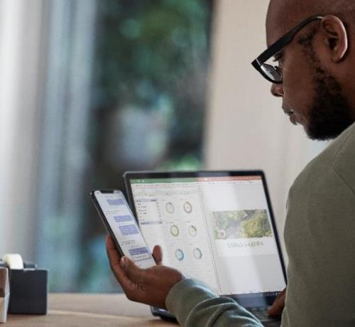
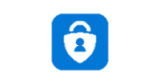

Verify identities with strong authentication
Including passwordless technology
Microsoft
Authenticator
Windows Hello
FIDO2 security key
Biometrics
Strong authentication prevents 99.9% of identity attacks
We support a broad range of strong authentication options
Push notification
Soft Tokens OTP
Hard Tokens OTP
SMS, voice
Notes:
Talk track:
Ensure users are who they say they are at every access attempt, and regularly reaffirm their trustworthiness. Multi-factor authentication protects your applications by using a second source of validation, (something they are and something they have) like a phone or token, to verify identity before granting access. With several available authentication methods available, Admins can choose the one that best fits their users’ workflow.
Passwordless methods help make MFA more convenient for users.
“Passwordless” Microsoft MFA credentials include:
Microsoft Authenticator: For the greatest flexibility, convenience, and cost, we recommend using the Microsoft Authenticator mobile app. Microsoft Authenticator supports biometrics, push notifications, and one-time passcodes for any Azure AD-connected app. It’s free to download from the Apple and Android app stores.
Windows Hello: For a great built-in experience on the PC, we recommend using Windows Hello. It uses your face or fingerprint to sign in automatically.
FIDO2 security keys are now available from several of our partners like Yubico, Feitian Technologies, and HID Global in a USB, NFC-enabled badge or biometric key.
We already have over 100M users of passwordless authentication, and this number is about to get bigger!¹ At Ignite we announced that in Q1 2020 we will extend passwordless authentication (in public preview) to include support for hybrid environments.

Slide 17
Demo - Configure multifactor authentication Wizard
https://aka.ms/mfawizard

Slide 18


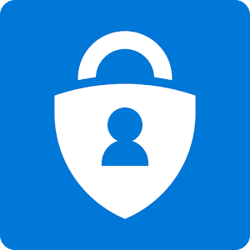
Deploy the most secure, usable & cost-effective methods
Bad: Password
Good: Password +
Better: Password +
Best
123456
qwerty
password
iloveyou
Password1
SMS
Push notification
Windows Hello
Software Tokens OTP
FIDO2 security key (Preview)
Voice
Hardware Tokens OTP
(Preview)
Microsoft Authenticator
(Preview)
Notes:
Best:
Windows Hello for Business
Phone Sign-in
FIDO 2.0 Security Keys
Good:
Password + Phone App (approval)
Password + OTP (Software or Hardware)
Bad:
Password + SMS
Password + Voice

Slide 19
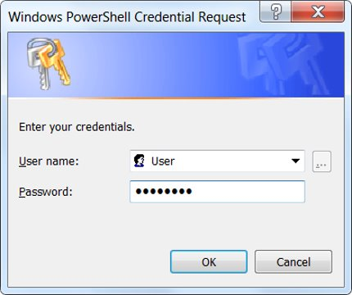
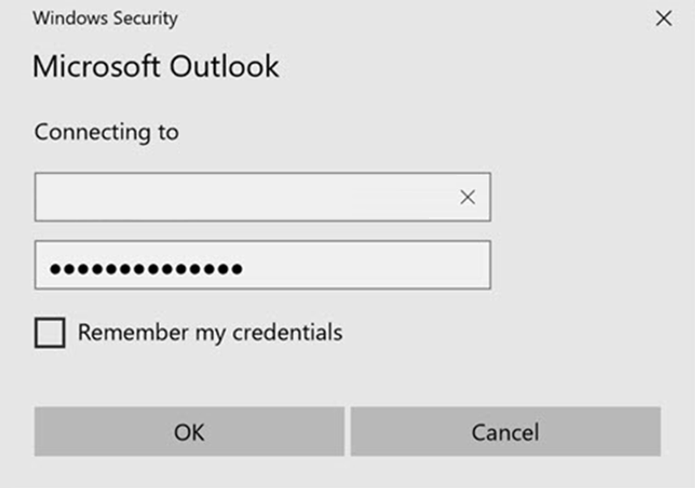
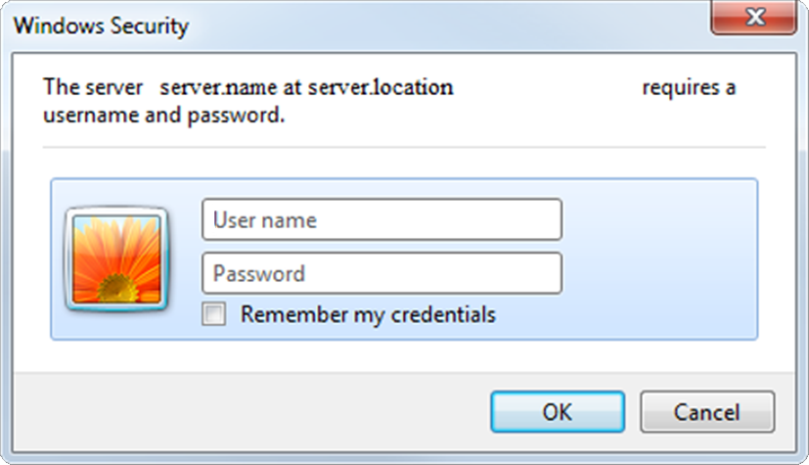
Block legacy authentication
Notes:
Apps using their own legacy methods to authenticate with Azure AD and access company data, pose another risk for organizations. Examples of apps using legacy authentication are POP3, IMAP4, or SMTP clients. Legacy authentication apps authenticate on behalf of the user and prevent Azure AD from doing advanced security evaluations. The alternative, modern authentication, will reduce your security risk, because it supports multi-factor authentication and Conditional Access. We recommend the following three actions:
Block legacy authentication if you use AD FS.
Setup SharePoint Online and Exchange Online to use modern authentication.
If you have Azure AD Premium, use Conditional Access policies to block legacy authentication, otherwise use Azure AD Security Defaults.

Slide 20
Winning strategies for strengthening your credentials
Enable MFA for all your admins (if you still haven’t)
Deploy strong authentication for all users
Start your passwordless journey
Block legacy authentication
Notes:
Enable MFA for all your admins if you still haven’t
Deploy strong authentication for all your users
Start your passwordless journey
Block legacy authentication

Slide 21
Winning strategy 2 Reduce your attack surface

Slide 22
Protect identities with Conditional Access and multifactor authentication
Signals
Verify every access attempt
Access apps and data
User and location
Device
Allow access
Require MFA
Limit access
Application
Real-time risk
Password reset
Monitor access
Notes:
Conditional Access is the #1 benefit that customers quote as a reason for choosing Azure AD. ​
Identity continues to be one of the top attack vectors, and you already know that multifactor authentication can prevent 99.9% of identity attacks. ​
Conditional Access makes MFA even more effective by prompting users only when necessary. ​
You can help your customers customize and manage automated policies and get reporting on the policies that apply for each sign-in. ​
Azure AD Identity Protection goes further to provide ongoing real-time risk detection and remediation of suspicious user accounts. ​

Slide 23
Risks with Privileged Access
# admins with highest levels of privileges over time
Admin #3
Number of permissions
Admin #2
Admin #1
Time
https://docs.microsoft.com/azure/active-directory/privileged-identity-management/pim-configure
Notes:
These are the folks who have lots of permissions, and tif they get compromised can cause extensive damage to your environment. Over time, you might have users assigned to admin roles and amass more and more admin privileges over time. Your risk increases.

Slide 24
What you want - Least Privileged Access
Secure and compliant by default, governed by the principle of Zero Standing Access, with Just-in-Time & Just-Enough-Access
Admin #3
Admin #3
Admin #1
Admin #1
Number of permissions
Admin #2
Password Admin 1 hr
Security Admin 2 hrs
Global Admin .5hr
Password Admin 1 hr
Global Admin .5 hr
Time
https://docs.microsoft.com/azure/active-directory/privileged-identity-management/pim-configure
Notes:
What you really want is… to not have standing admin access. Instead, your admins should have just enough access and just in time for when it is needed. This helps reduce your users’ risk profile so even if a privileged user gets phished or attacked, your overall risk is vastly reduced.

Slide 25
Privileged Identity Management
Discover, restrict, and monitor privileged identity access
User
Administrator
Administrator privileges expire after a specified interval
User
Enforce on-demand, just-in-time administrative access when needed
Ensure policies are met with alerts, audit reports and access reviews
Manage admins access in Azure AD and in Azure RBAC
Notes:
Implement Azure AD Privileged Identity Management
Azure AD Privileged Identity Management (PIM) helps you minimized account privileges by helping you:
Identify and manage users assigned to administrative roles.
Understand unused or excessive privilege roles you should remove.
Establish rules to make sure privileged roles are protected by multi-factor authentication.
Establish rules to make sure privileged roles are granted only long enough to accomplish the privileged task.
Enable Azure AD PIM, then view the users who are assigned administrative roles and remove unnecessary accounts in those roles. For remaining privileged users, move them from permanent to eligible. Finally, establish appropriate policies to make sure when they need to gain access to those privileged roles, they can do so securely, with the necessary change control.
As part of deploying your privileged account process, follow the best practice to create at least two emergency accounts to make sure you still have access to Azure AD if you lock yourself out.
25

Slide 26

Azure AD entitlement management
User onboarded
Azure AD entitlement management provides access lifecycle management for both employees and guests
You can define policies for who can request an access package, and include multi-stage approval workflow, and recurring access reviews
Access is time-limited, and guests are removed from the directory when their last access assignment expires
Azure AD access reviews ensures oversight and removes access when no longer needed
Job changes
Ongoing auditing & reporting
Access reviewed & revised
Requests additional access
Access rights provisioned
Notes:
Futhermore, to really reduce your attack surface you want to use our advanced governance solutions – such as entitlement management. Entitlement Management provides lifecyle management for your employees as well as non-employees such as business partners or vendors. You can create pre-defined packages of resources that contain resources such as groups, apps, and sharepoint sites. You can then define policies on who can request access, for how long, and include approval workflows. Finally, users’ access is always time bound and is reviewed via Azure AD access reviews.

Slide 27
Winning strategies for reducing your attack surface
Enable timebound just-in-time (JIT) access via Privileged Identity Management if you haven’t
Block invalid authentication points via Conditional Access
Perform lifecycle management via Entitlement Management
Periodically recertify privileged users via Access Reviews
Require admins to elevate permissions when needed for sensitive apps

Slide 28
Winning strategy 3 Automate threat response

Slide 29

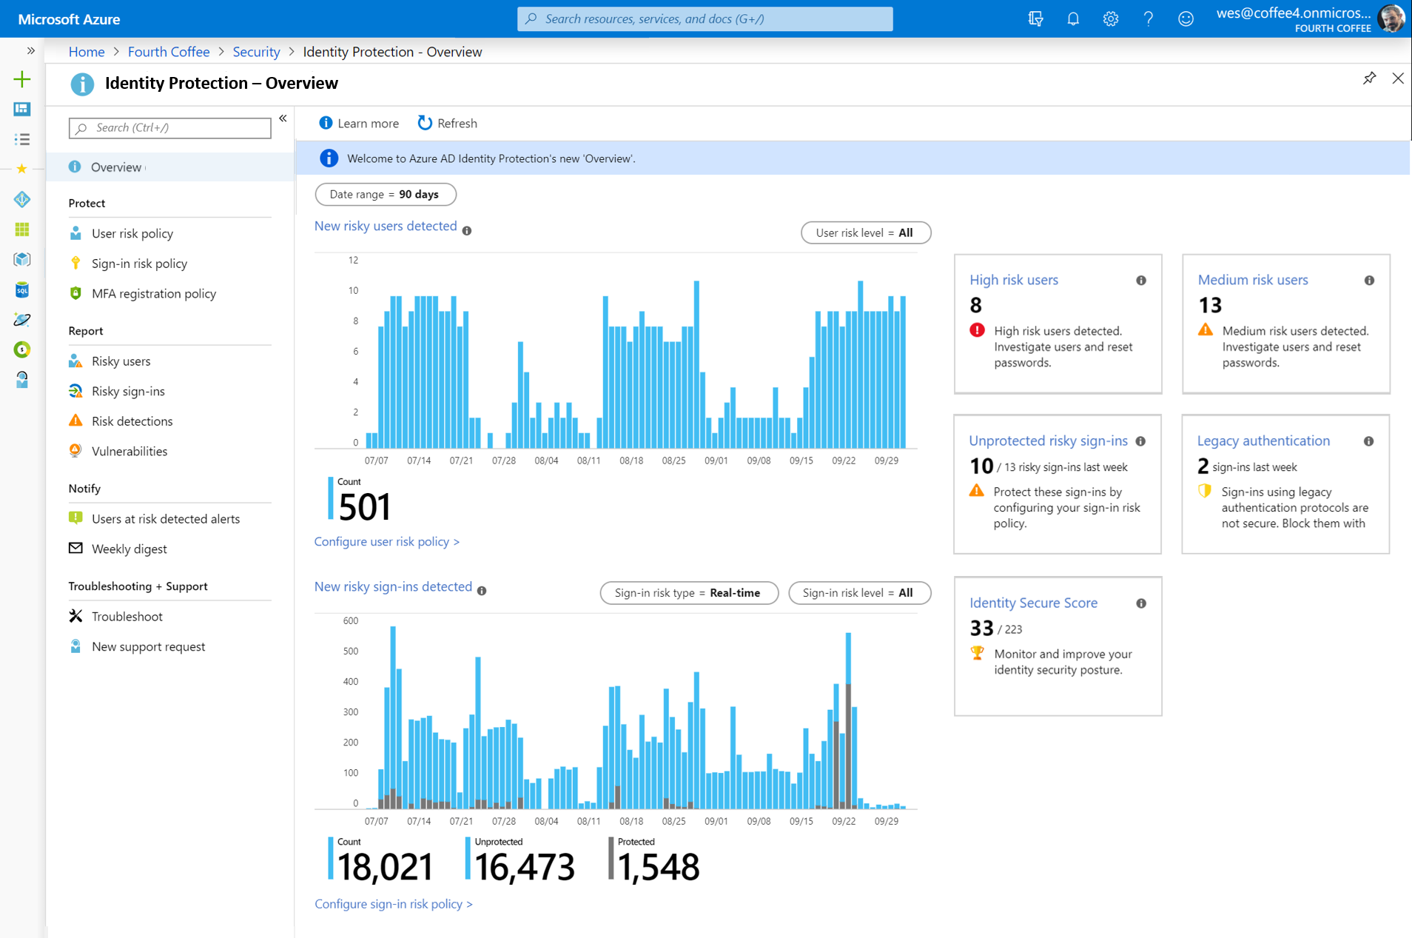
Azure AD · Identity Protection
Gigantic datasets
World-class machine learning
Security experts
Continuously evolving algorithms
Global threat intelligence
Realtime, automated mitigations
Notes:
Implement user risk security policy using Azure AD Identity Protection
User risk indicates the likelihood a user's identity has been compromised and is calculated based on the user risk detections that are associated with a user's identity. A user risk policy is a Conditional Access policy that evaluates the risk level to a specific user or group. Based on Low, Medium, High risk-level, a policy can be configured to block access or require a secure password change using multi-factor authentication. Microsoft's recommendation is to require a secure password change for users on high risk.
Implement sign-in risk policy using Azure AD Identity Protection
Sign-in risk is the likelihood someone other than the account owner is attempting to sign on using the identity. A sign-in risk policy is a Conditional Access policy that evaluates the risk level to a specific user or group. Based on the risk level (high/medium/low), a policy can be configured to block access or force multi-factor authentication. Make sure you force multi-factor authentication on Medium or above risk sign-ins.

Slide 30


Identity Protection intelligently detects and responds to compromise
Continuously improving to prevent attack
Improved machine learning
Real time session risk
Extended threat intelligence
More Microsoft ecosystem
innovation
MCAS, Azure ATP
Microsoft Graph API and Security Graph, Logic apps
Investigation
Risk assessment
Policy enforcement
Automated remediation
Notes:
Identity Protection continually improves our ML
Not just using heuristics but leveraging machine in our real time session risk evaluations.
This is the best way to protect your users because outside of policies and rules that are configured, our system keeps on refining risk.
Our new ML system logic with real time session risk evaluation continues to improve and evolves to secure your users better.
Mcas and continually improving our integrations with 1st and 3rd party.
> Intro our data scientist, will dive deeper into our updates
Our new ML system logic with real time session risk evaluation continues to improve and evolves to secure your users better.
We have a new high risk blocking with improved similar to IP blocking and Smart Lockout.
By refining the risk leve l of each real time detection we’ve seen significant improve in the precision of these detections.

Slide 31








Azure AD · Identity Protection · Risk types
Users with leaked credentials
Sign-ins from anonymous IP addresses
Impossible travel to atypical locations
?
Sign-ins from infected devices
Sign-ins from IP addresses with suspicious activity
Sign-ins from unfamiliar locations
New risk alerts are added as new threats emerge

Slide 32
Winning strategies for automating threat response
Require MFA or block risky sign-ins via Conditional Access
Enforce secured password change or block risky users via Conditional Access

Slide 33
Winning strategy 4 Utilize cloud intelligence

Slide 34
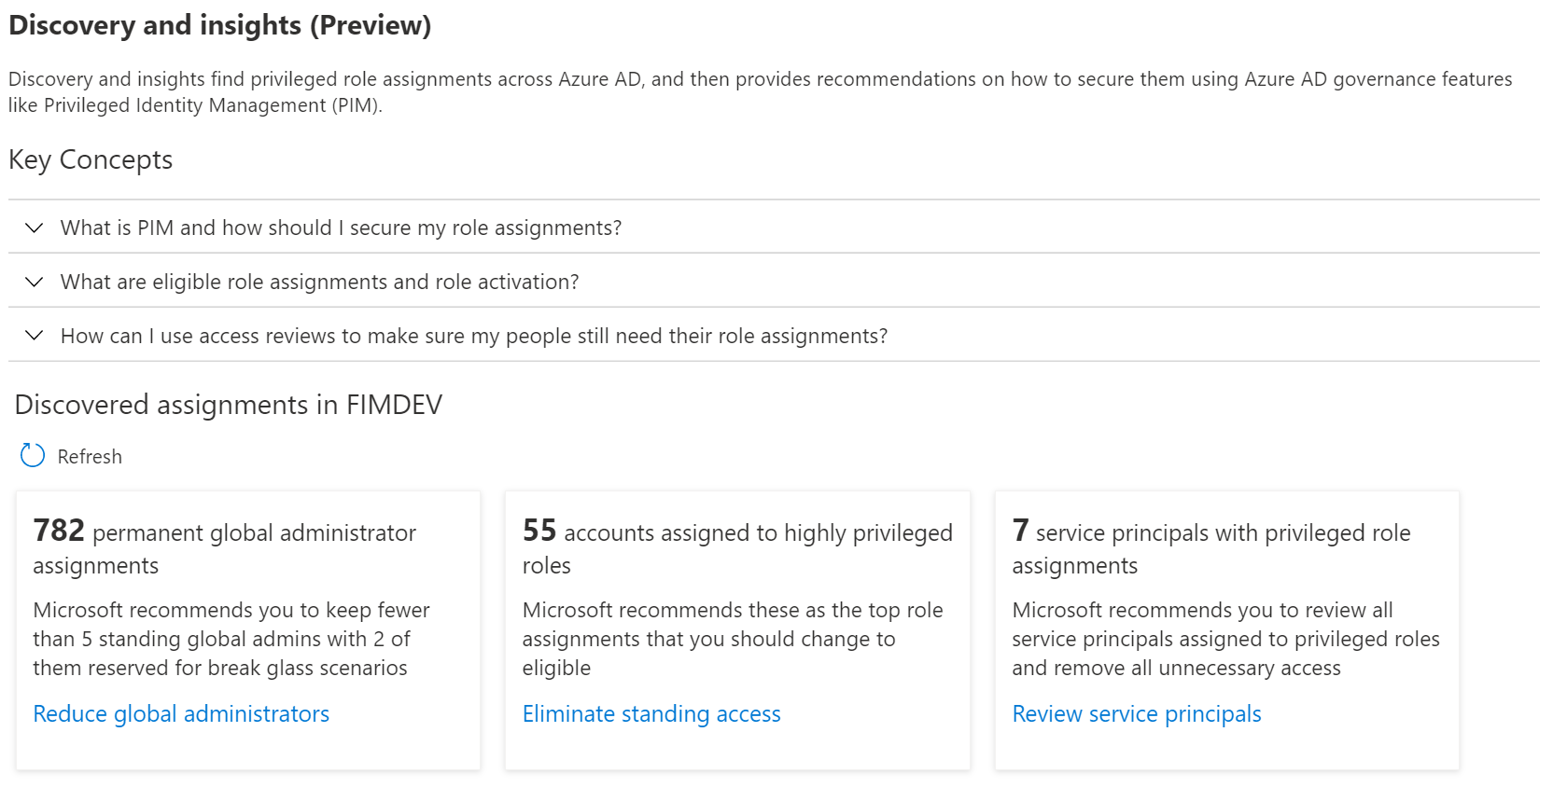
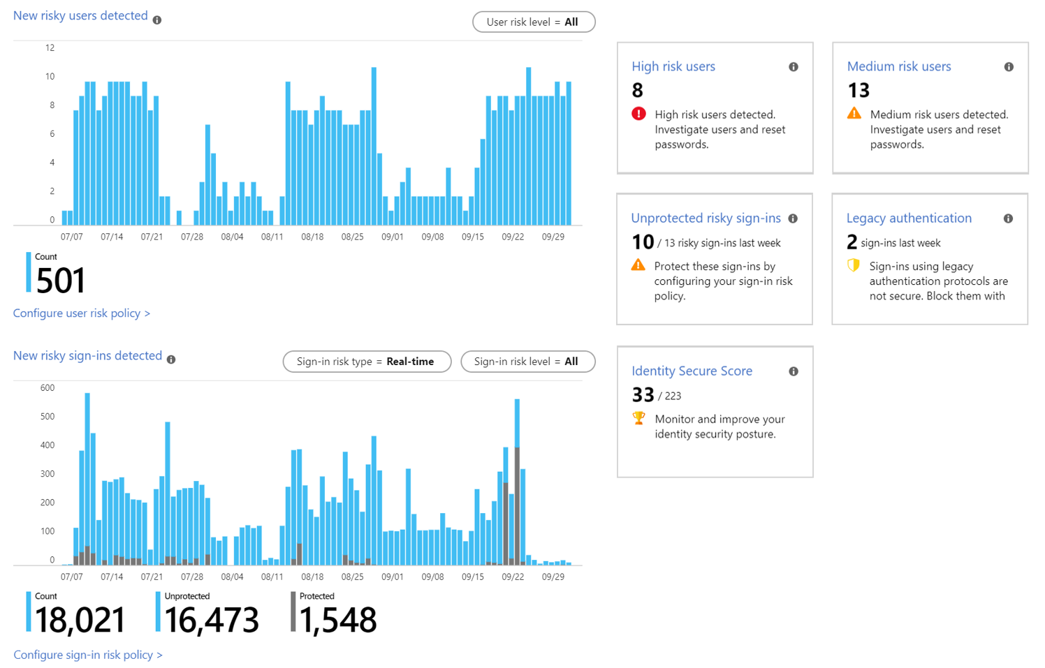
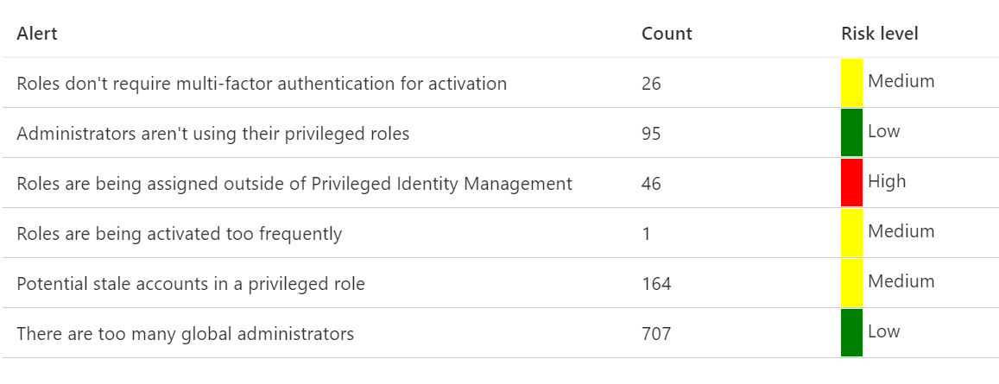
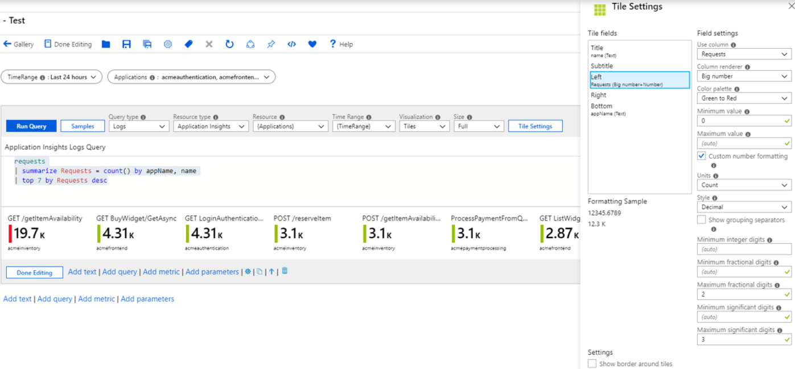
Actionable insights in Azure AD
Identity Protection
Privileged Identity Management
Workbook analytics:
CA insights
Legacy authentication workbook
Access package activity
Notes:
There is a ton of rich actionable insights available to you in Azure AD. Some of which we’ve already shown you earlier – for example, Identity Protection delivers insights such as risky users…sign-ins… impossible travel and also integrates across Microsoft products like Microsoft Cloud App Security. Another source of insights is Privileged Identity Management - which delivers insights such as the number of inactive admins in your tenant, or admins who don’t have safety controls like as MFA turned one., and then there is Workbook analytics which is a customizable analytics platform that delivers a whole host of insights related to Conditional Access, Legacy Authentication, Access Package activity, and much more.

Slide 35
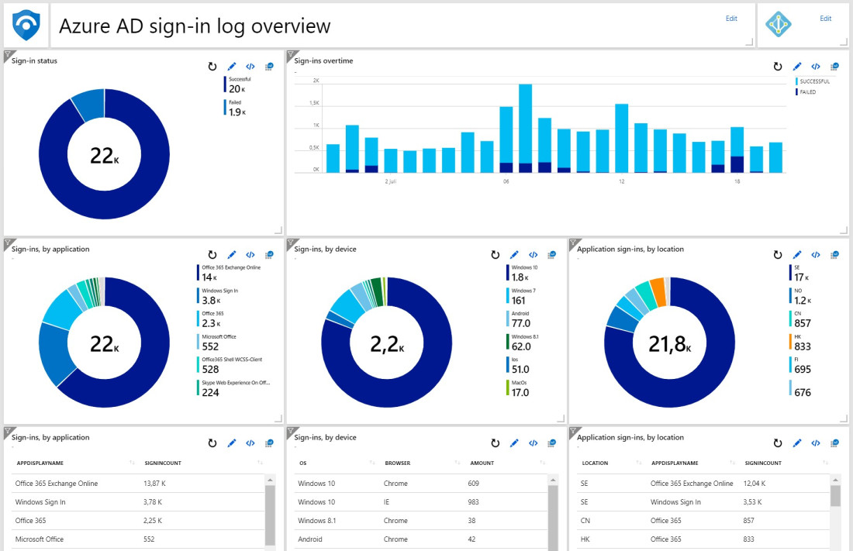
Azure Sentinel integration
Notes:
You can stream logs from Azure AD Identity Protection into Azure Sentinel to stream alerts into Azure Sentinel to view dashboards, create custom alerts, and improve investigation. Azure Active Directory Identity Protection provides a consolidated view at risk users, risk detections and vulnerabilities, with the ability to remediate risk immediately, and set policies to auto-remediate future events. The service is built on Microsoft’s experience protecting consumer identities and gains tremendous accuracy from the signal from over 13 billion log-ins a day.

Slide 36
Winning strategies for utilizing cloud intelligence
Watch for alerts emails - Privileged Identity Management activation and Identity Protection
Check your identity secure score
Monitor your Azure AD audit and sign-in logs
Strengthen your Conditional Access policies and Privileged Identity Management via insight reporting
Create dashboards with Azure AD workbooks
Notes:
So everything we just talked about is available for you to explore today. At minimum you should make sure you pay attention to the emails, periodically monitor all the alerts and insights we provide in Azrue AD and use our APIs to integrate with your SIEM solutions. The faster your time to response, the better your security posture will be.

Slide 37
Winning strategy 5 Empower end users with self-service

Slide 38

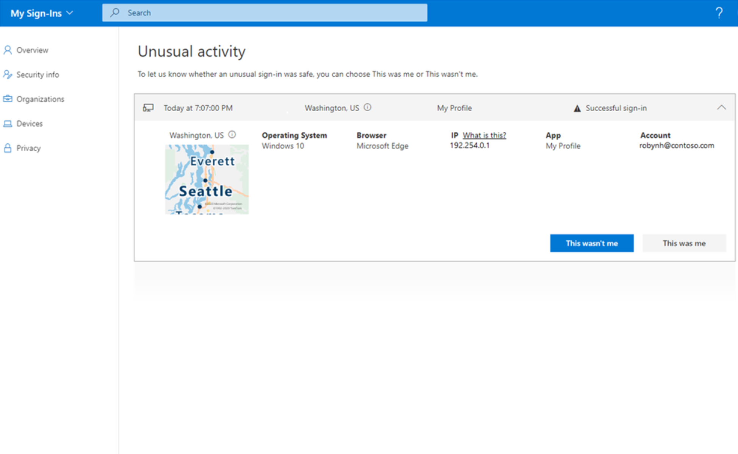
My sign-ins · Users can report unusual sign-ins
MySignins page shows all sign-ins for the user including unusual activity.
“Looks unfamiliar?” and
“This wasn’t me” to report unusual activities.
If sign-in is reported suspicious, user will be routed to the “Security info” page to change password and take further steps to secure their account

Slide 39
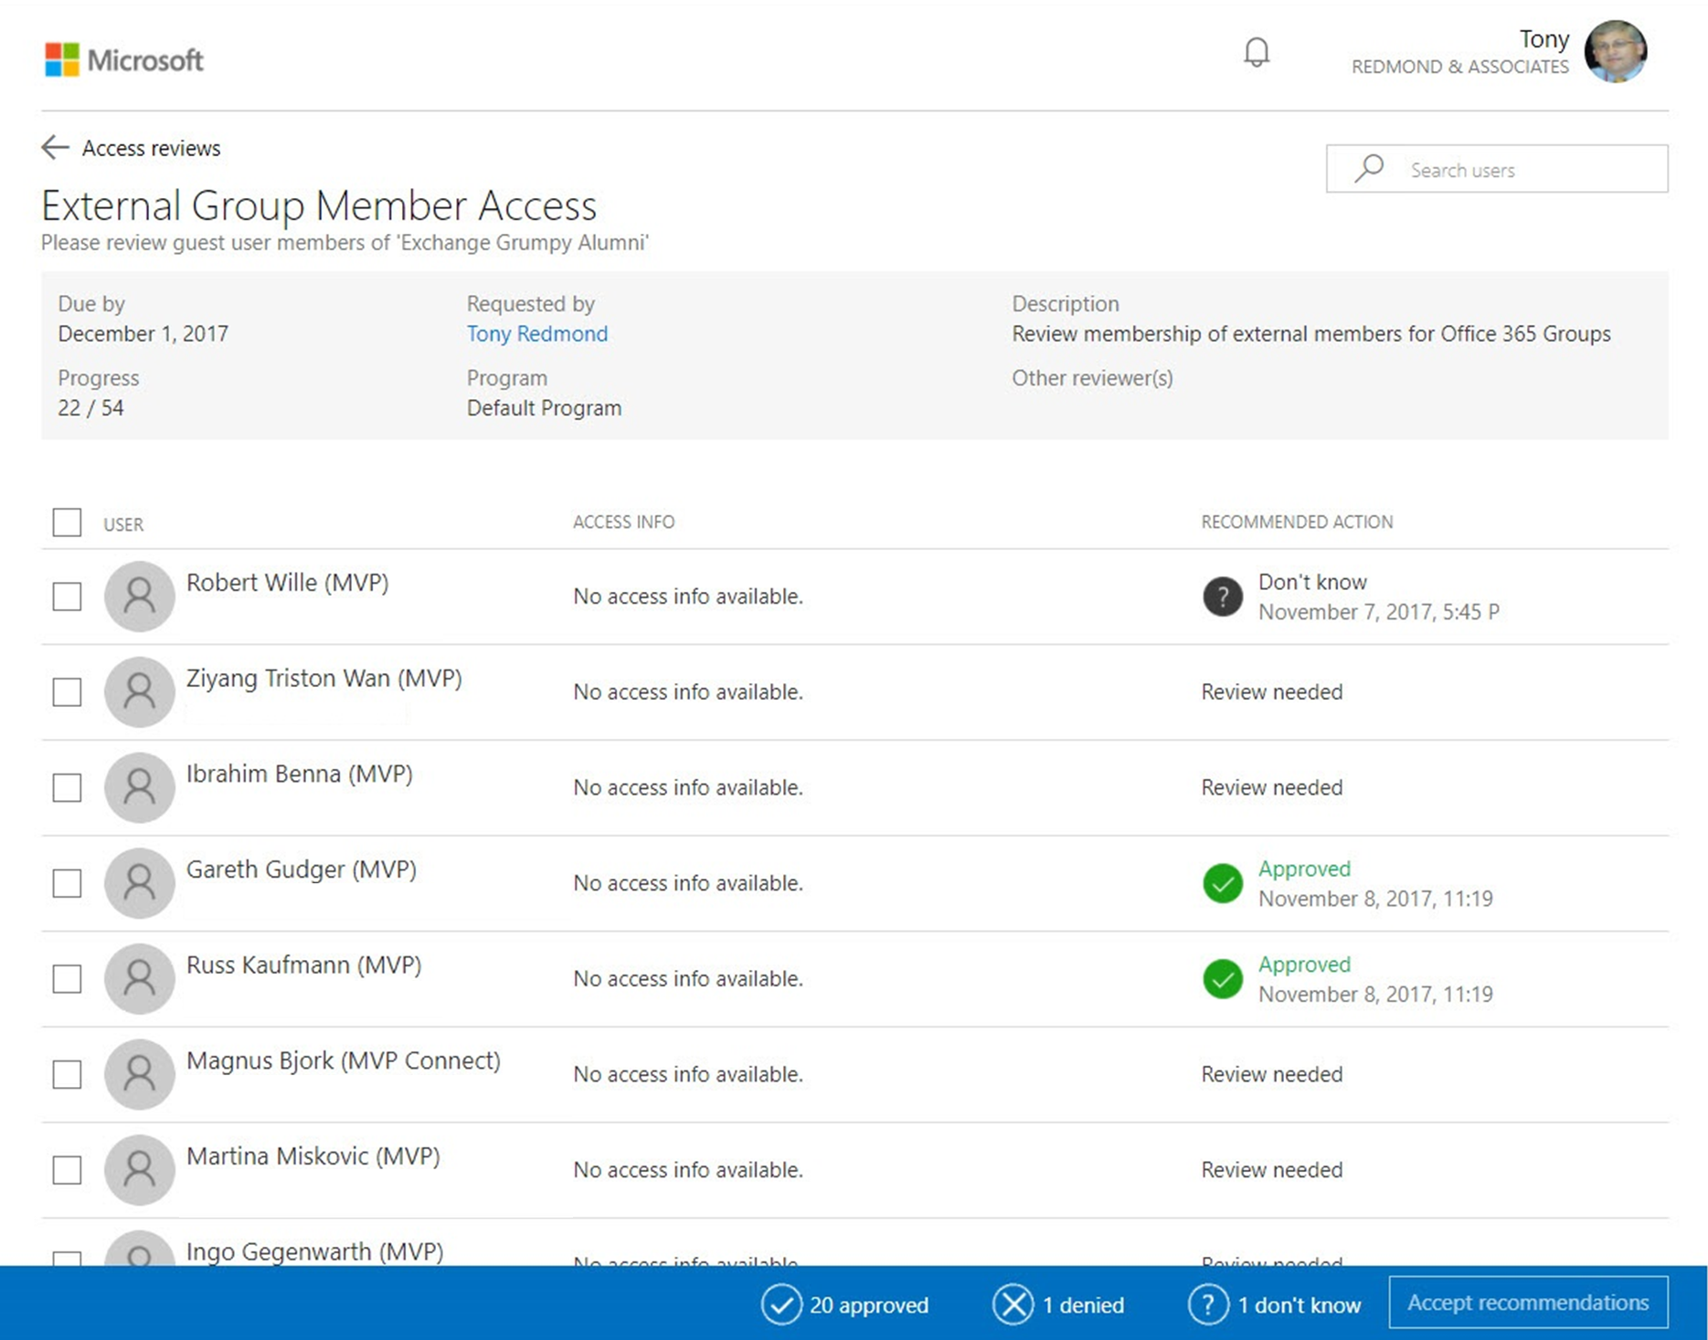
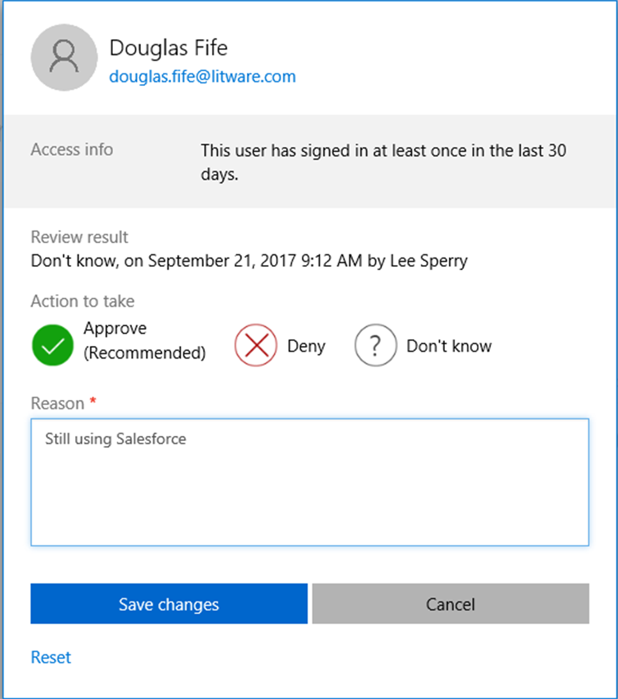
Access Reviews
Provide oversight for which users have access to what resources
Prompts users to ensure their access is limited to the resources they need
Applies to employees and guest users
Notes:
Implement Azure AD access reviews
With Azure AD access reviews, you can manage access package and group memberships, access to enterprise applications, and privileged role assignments to make sure you maintain a security standard. Regular oversight by the users themselves, resource owners, and other reviewers ensure that users don't retain access for extended periods of time when they no longer need it.
39

Slide 40
Winning strategies for end user self-service
Empower users with self-service password reset and group / application access
Maintain access compliance with Azure AD access reviews
Create access packages via Entitlement Management
Train users how to self-report risky sign-ins and verify their Security contact information

Slide 41
5 winning strategies
Strengthen your credentials
Increase your awareness with auditing and monitor security alerts
MFA reduces compromise by 99.99%
Attackers escape detection inside a victim’s network for a median of 101 days. (Source: FireEye)
Reduce your attack surface
Enable self-help for more predictable and complete end user security
Blocking legacy authentication reduces compromise by 67%.
60% of enterprises experienced social engineering attacks in 2016. (Source: Agari)
Automate threat response
Implementing risk policies reduces compromise by 96%
https://aka.ms/securitysteps
Notes:
41

Slide 42
Thank you

